Slide 1
College Enrollment, Graduation, & Employment
Aparna, Brandi and Carter

Slide 2

Motivation and Summary
* Define the core message or hypothesis of your project.
Our project goal is to compare enrollment rates & completion rates to employment in the US over time.
* Describe the questions you asked, and _why_ you asked them
* Describe whether you were able to answer these questions to your satisfaction, and briefly summarize your findings
TBD

Slide 3
Questions & Data
* Elaborate on the questions you asked, describing what kinds of data you needed to answer them, and where you found it
i. Is there a relation between employment levels and enrollment rates? ii. As the employment level declines, does the enrollment rate increase? iii. Is there a predictive relationship between employment level and enrollment rate? iv. Enrollment vs. completion rate v. Completion rate vs. job opportunities over time (if time and data allows)
Data: Annual enrollment, institution count, and completion rates for colleges. Unemployment rate, labor force participation rate, and jobless claims rates.
Sources: IPEDS, FRED

Slide 4
Data Cleanup & Exploration
* Describe the exploration and cleanup process * Discuss insights you had while exploring the data that you didn't anticipate
Enrollment: Completion: Economic Data: Labor force participation has been in almost continuous decline over the period in question, regardless of point in economic cycle
* Discuss any problems that arose after exploring the data, and how you resolved them
Enrollment: Completion: Economic Data: Labor force participation has been in almost continuous decline over the period in question, regardless of point in economic cycle
* Present and discuss interesting figures developed during exploration, ideally with the help of Jupyter Notebook
CHARTS GO HERE ☺

Slide 5
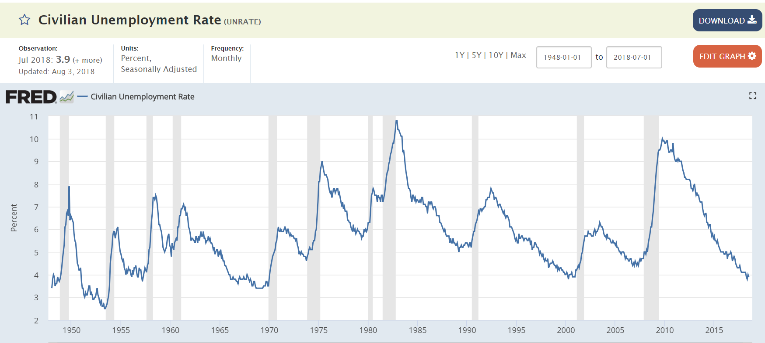
Data Cleanup & Exploration - FRED
FRED Exploration
Economic data
>500k data series
FRED Data Files Obtained
Monthly unemployment (2000-2018)
Monthly labor force participation (2000-2018)
Weekly unemployment claims (2000-2018)
Cleanup
Removed extraneous columns
Averaged data annually to match NCES data
Problems
Different frequency of observations than NCES data

Slide 6
Data Analysis
* Discuss the steps you took to analyze the data and answer each question you asked in your proposal * Present and discuss interesting figures developed during analysis, ideally with the help of Jupyter Notebook
CHARTS GO HERE ☺

Slide 7
Discussion
* Discuss your findings. Did you find what you expected to find? If not, why not? What inferences or general conclusions can you draw from your analysis?

Slide 8
Post Mortem
* Discuss any difficulties that arose, and how you dealt with them * Discuss any additional questions that came up, but which you didn't have time to answer: What would you research next, if you had two more weeks?

Slide 9
Questions
* Open-floor Q&A with the audience

